Slide 1
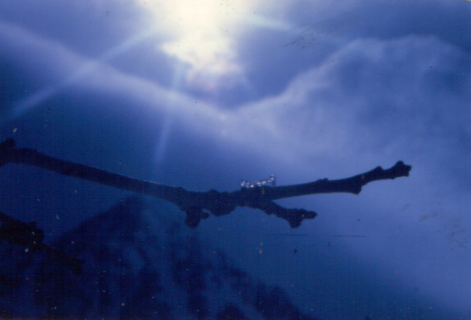
The Alkaline pH of the Body:
The Key To Sustainable Energy
and the Prevention of Disease!

Slide 2
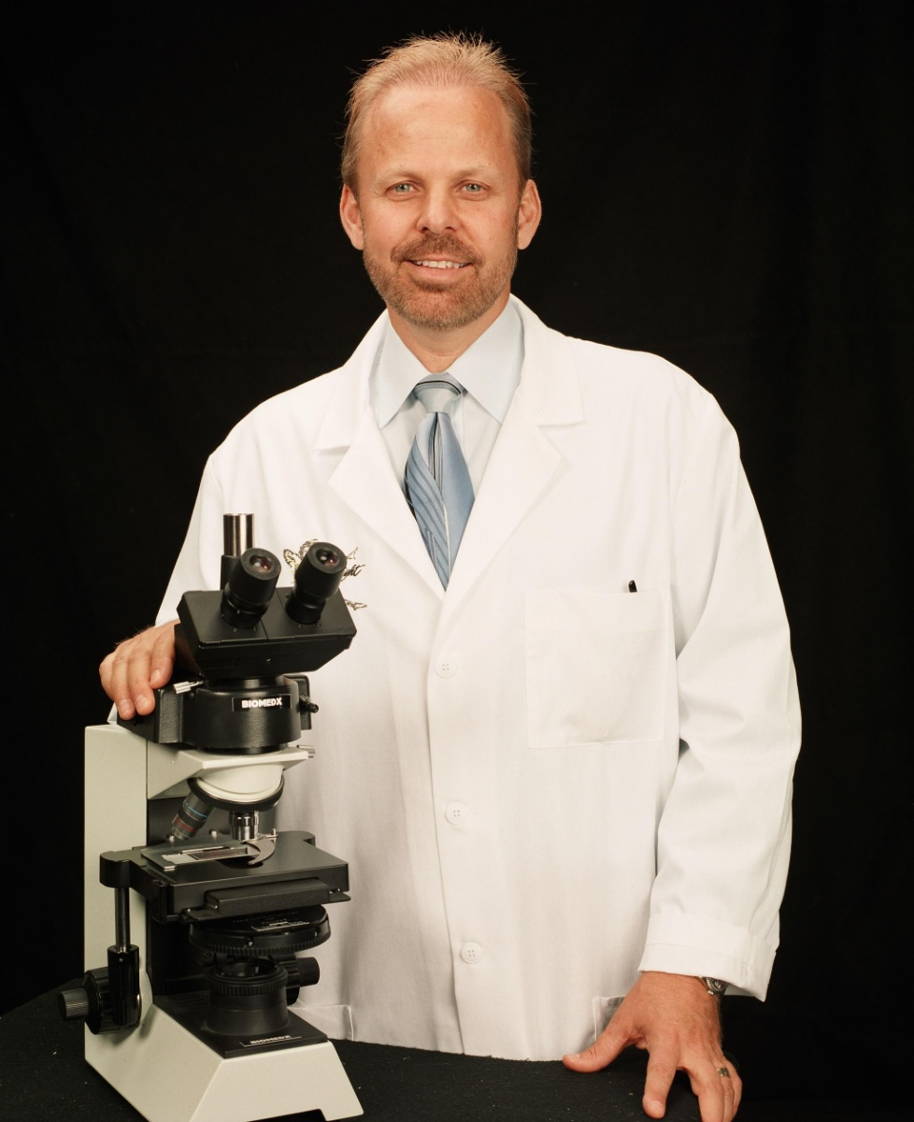
Hello, I’m Dr. Robert Young
Traditional Microbiology & Chemistry Training
Germ Theory
First witnessed biological transformation in 1994
Started studying the effects of diet on the blood & tissues
Discovered the pH connection and what we eat and drink does make a difference

Slide 3
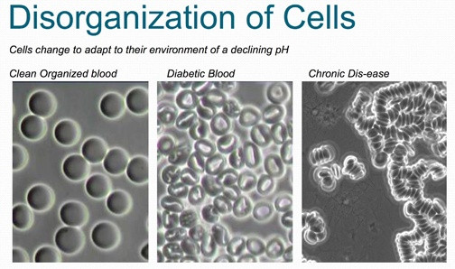
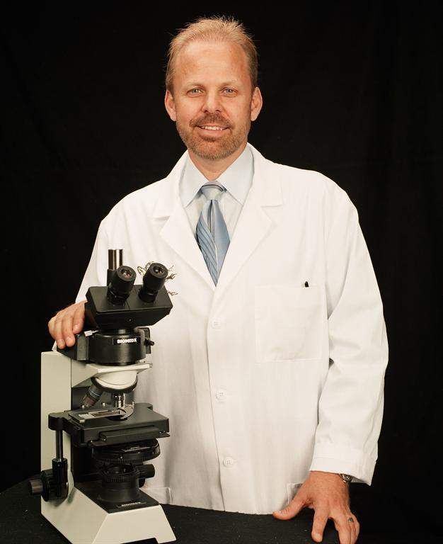
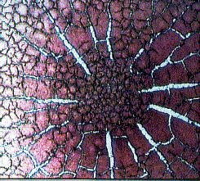
Live and Dried Blood Microscopy

Slide 4
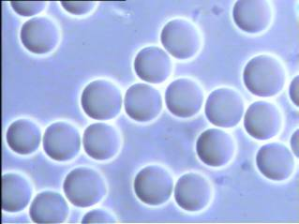

Slide 5
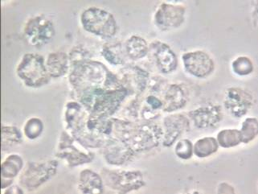

Slide 6
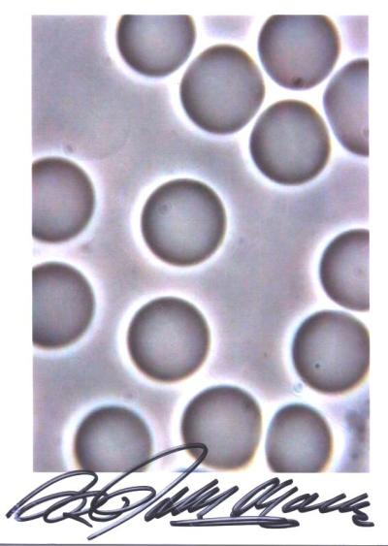
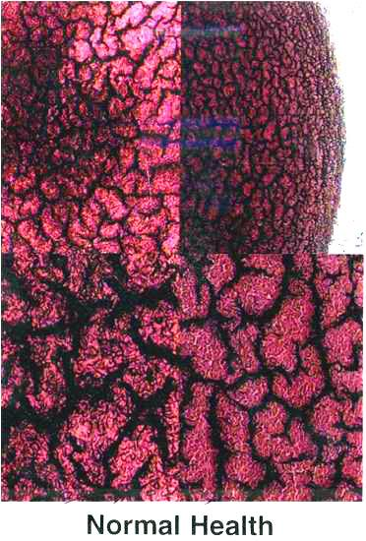
This is your blood on GREENS & 80% RAW, GREEN, FOODS
Keeping your blood Alkalized between 7.365-7.4 on a pH scale.
Healthy Organized Live Blood
Healthy Organized Dry Blood
The blood is smooth, perfectly rounded, plump, & even in color. The plasma is clean & clear.
This blood is bright red with good fibrin connection & single coast line. There are no white acid puddles.

Slide 7
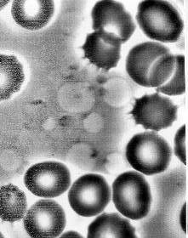
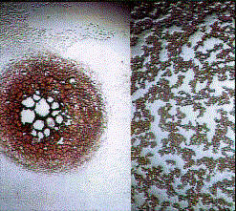
This is your blood on JUNK FOODS, SUGAR, ANIMAL PRODUCTS, Etc.!
Any Questions?
Unhealthy Disorganized Blood
Unhealthy Disorganized Blood
These RBC’s are fermenting from a diet too high is dead foods & sugar (i.e. junk food, high sugar fruits, pastas, breads)
This is a Colon Cancer / AIDS Profile in a medically diagnosed client. (White puddles indicate acid disorganizing the blood)
Notes:
Sugar makes your blood and immune system move like I-4 in downtown Orlando from 4-5pm… dead halt!
Specific acids have been linked to many if not all of the major dis-ease symptomologies that plague humanity:
-Waste from Yeast and Lactic Acid (dairy and sugar) linked to Cancer and Aids
-Uric Acid (urine acid of animal) linked to Arthritis and Gout
-Acetic Acid/Acetyl Aldehyde (alcohol, ferments, sugar) linked to MS, Alzheimer's, and other neurological disorders

Slide 8
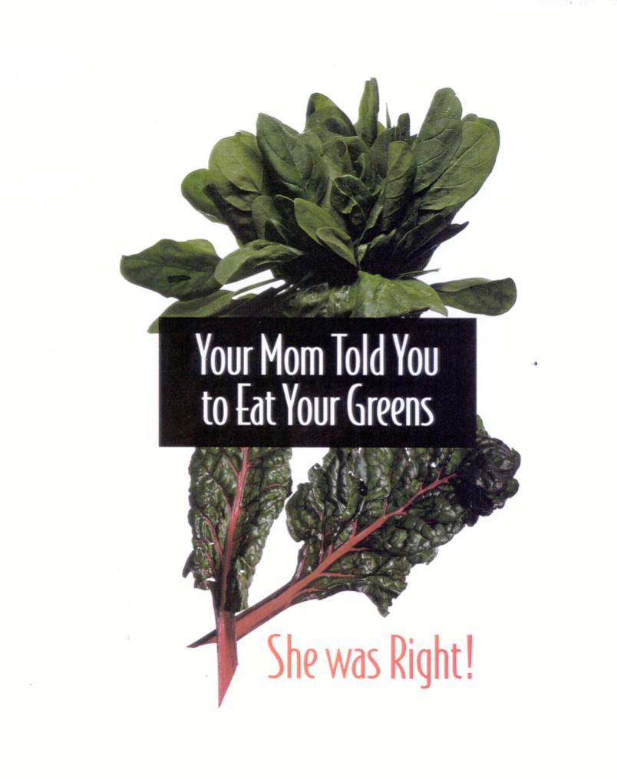

Slide 9
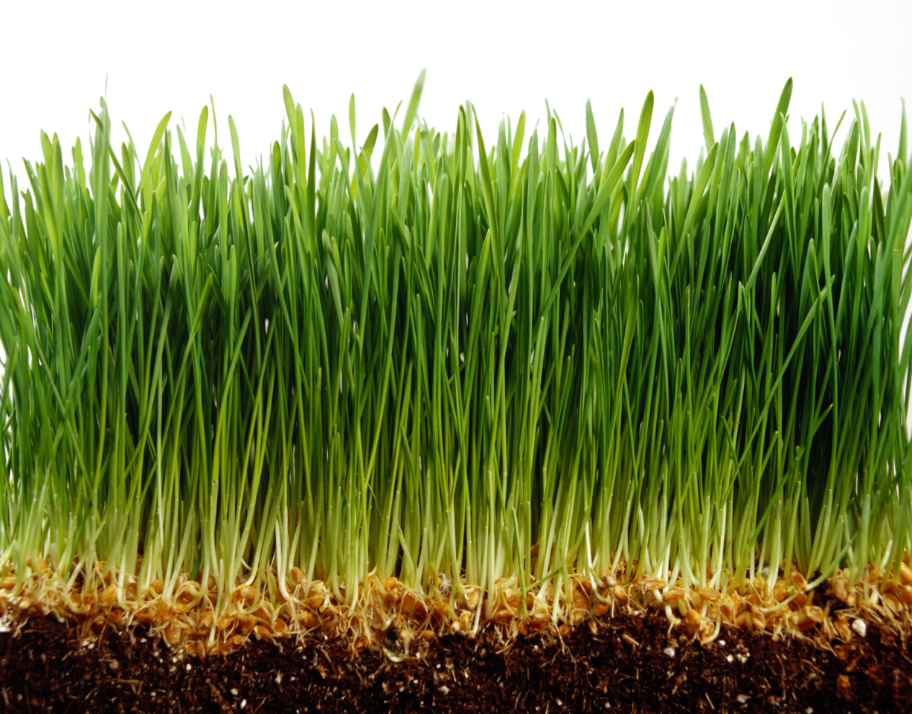

Slide 10
All Flesh is Grass.
Isaiah 40: 6

Slide 11
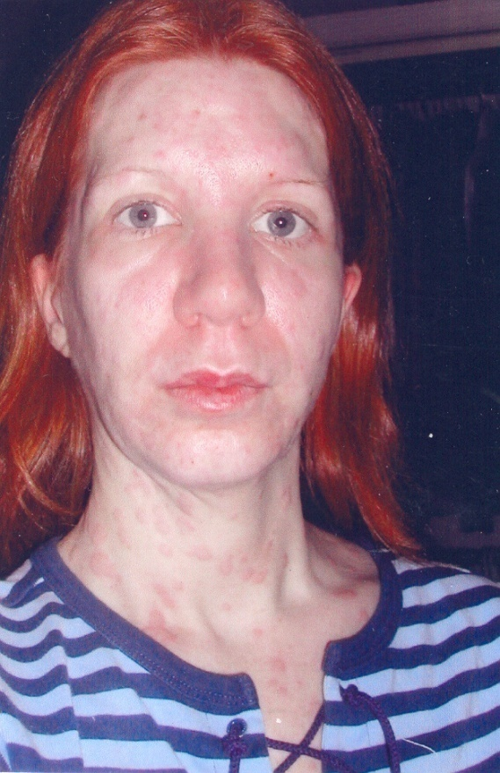

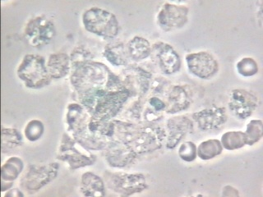
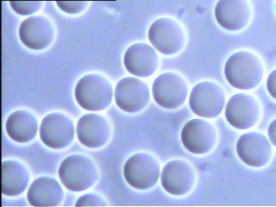
Blood becomes Skin

Slide 12
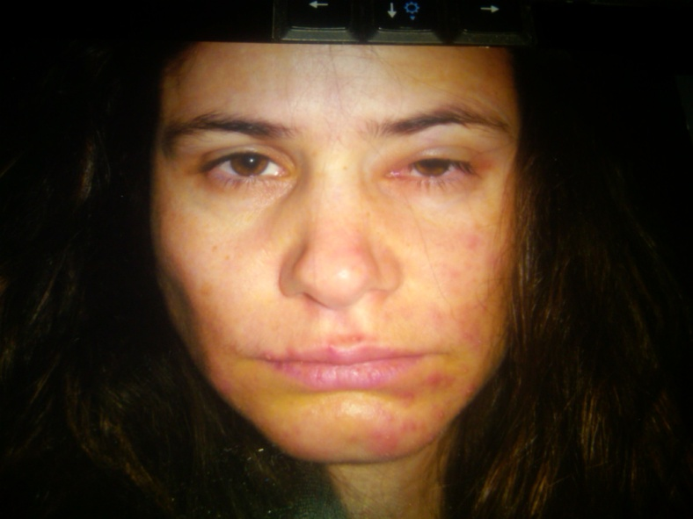

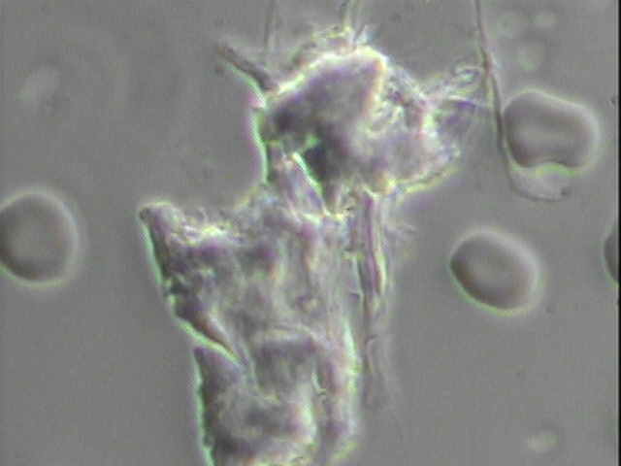
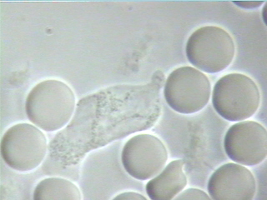
Bell’s Palsy/Facial Paralysis

Slide 13
The Doctor of the Future will give no medicine, but will involve the patient in the proper use of food, fresh air, and exercise.
Thomas Edison

Slide 14

The pH Miracle Living Center
San Diego, California

Slide 15


Slide 16
Clinical Research at The pH Miracle Living Center
All Cancers
Type I and II Diabetes
Heart Disease
Neurological Disease
Dermatological conditions
Reproductive conditions
Gastrointestinal conditions
Metabolic disorders
Over 1000 scientific articles on health, nutrition, and fitness www.articlesofhealth.blogspot.com
www.phmiracleliving.com

Slide 17
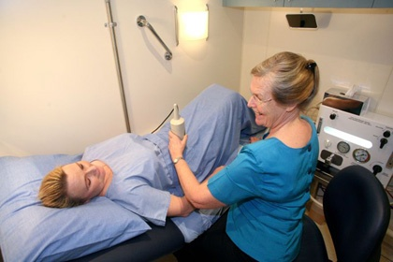
Alkalizing Colon Therapy

Slide 18

Alkalizing Hypothermia Therapy

Slide 19

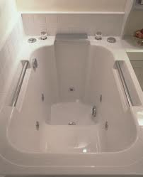
Alkalizing Hydrotherapy with Mineral Salts

Slide 20

Alkalizing Massage

Slide 21
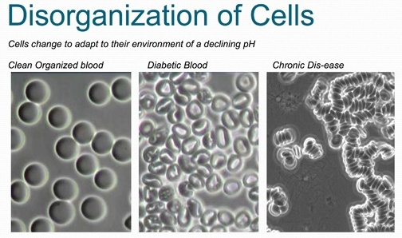
Live and Dried Blood Microscopy

Slide 22
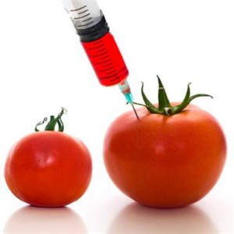
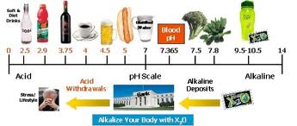

Monitoring Health With pH

Slide 23
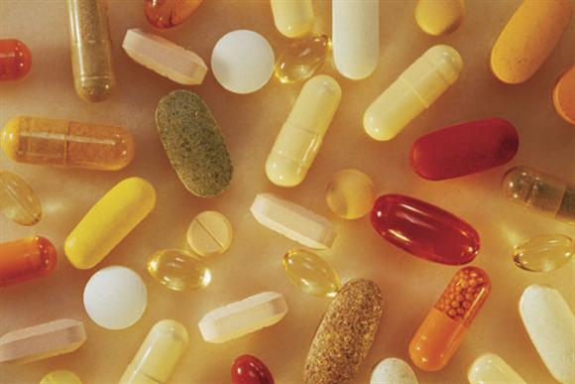
Alkalizing Nutrition

Slide 24

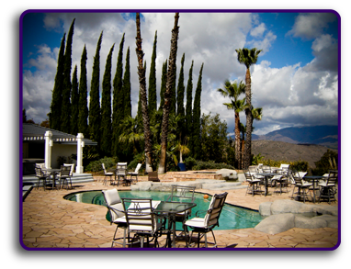
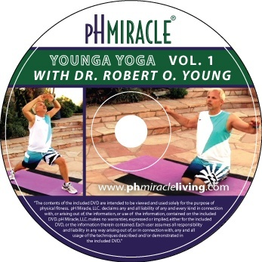

Alkalizing Exercise – Younga Yoga

Slide 25
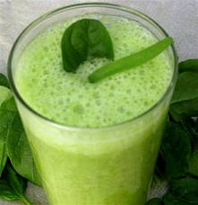
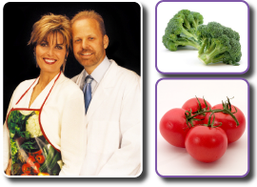
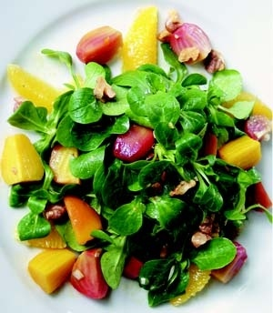
Alkalizing Food by Shelley

Slide 26

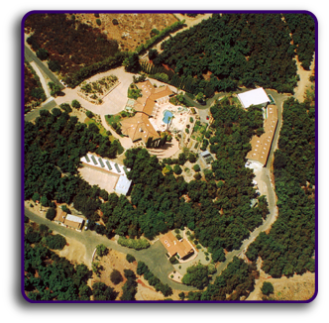

Alkalizing Accommodations
Maui and Kaua’i Hawaii in January
Marbella, Spain in July
Phuket, Thailand in October
Retreats throughout the year at the
Rancho del Sol in San Diego

Slide 27
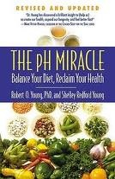

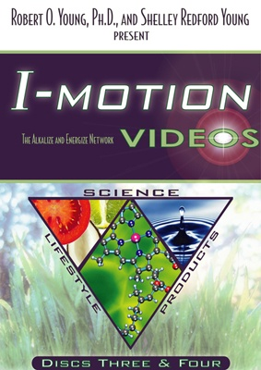


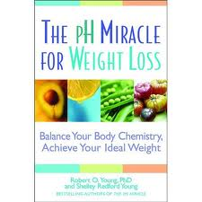

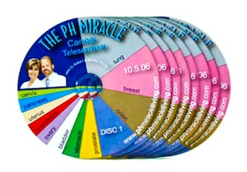
Alkalizing Education

Slide 28
Clinical Research at The pH Miracle Living Center
All Cancers
Type I and II Diabetes
Heart Disease
Neurological Disease
Dermatological conditions
Reproductive conditions
Gastrointestinal conditions
Metabolic disorders
Over 1000 scientific articles on health, nutrition, and fitness www.articlesofhealth.blogspot.com
www.phmiracleliving.com

Slide 29
A pH Miracle
“A natural phenomenon that is not understood by current medical savants in the cause and effect relationship”
Dr. Robert O. Young

Slide 30

The Fish Bowl Metaphor
When the fish is sick what would you do, treat the fish or change the water?

Slide 31
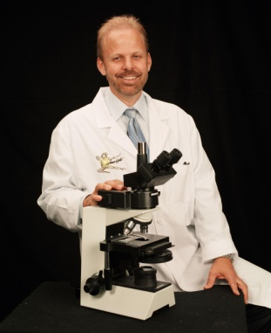
Today We Are Going To Talk About
The Human Body Is Alkaline by Design
All Functions of the Human Body Are Acidifying to the Blood and Tissues
There is only one disease, one sickness, one health and one treatment
The single most important factor in maintaining health and energy is the pH of the blood, urine and saliva
Life and Death begins in the small bowel.
Light energy is the driving force of every cell.

Slide 32

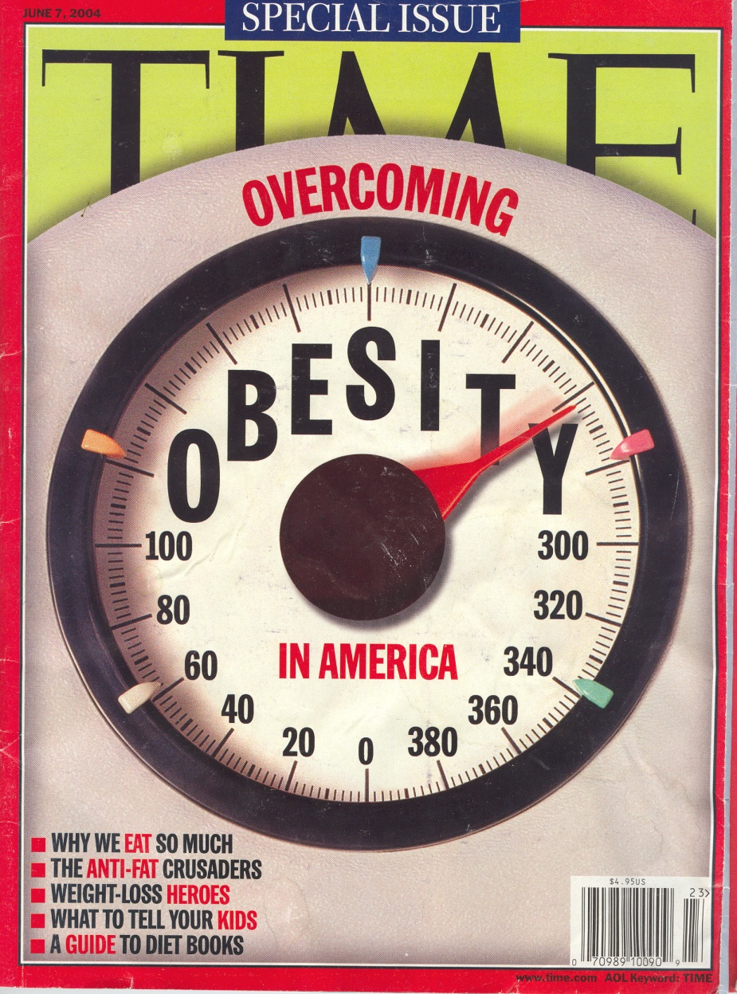
Fat Nation

Slide 33


61% OF US,
127 MILLION PEOPLE
ARE OVER WEIGHT

Slide 34
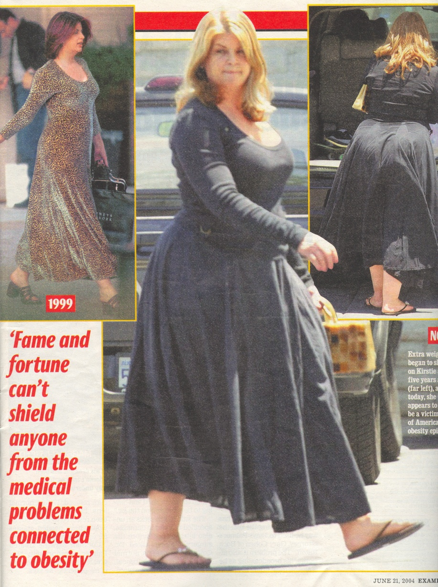
Obesity Boosts the Risk of the Top Three Killers
Obesity is nearly as deadly as tobacco, warns the U.S. Center for Disease.
In 2000, poor diet including lack of exercise caused 400,000 deaths – more than 16% of all deaths and the most preventable killer according to the CDC.

Slide 35
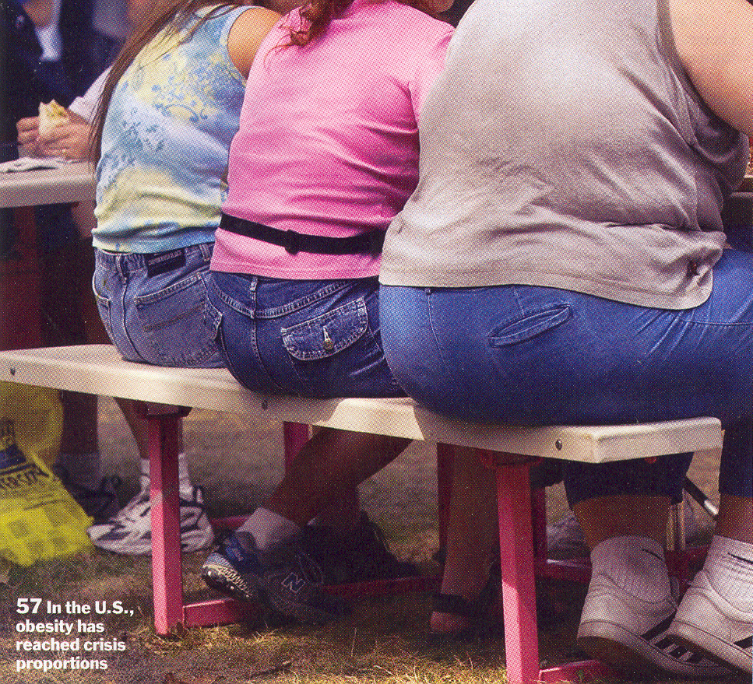
Obesity Facts
4 Million Americans are tipping the scales at more than 300 pounds.
There are 1.1 million U.S. women who weigh in excess of 300 pounds.
There are more than 400,000 Americans who weigh more than 400 pounds.
One in Nine U.S. adult males are more than 250 pounds, while one in six women is tipping the scale at 200 pounds or more.
The average weight of the American woman is 163 pounds and the American male is 196.

Slide 36
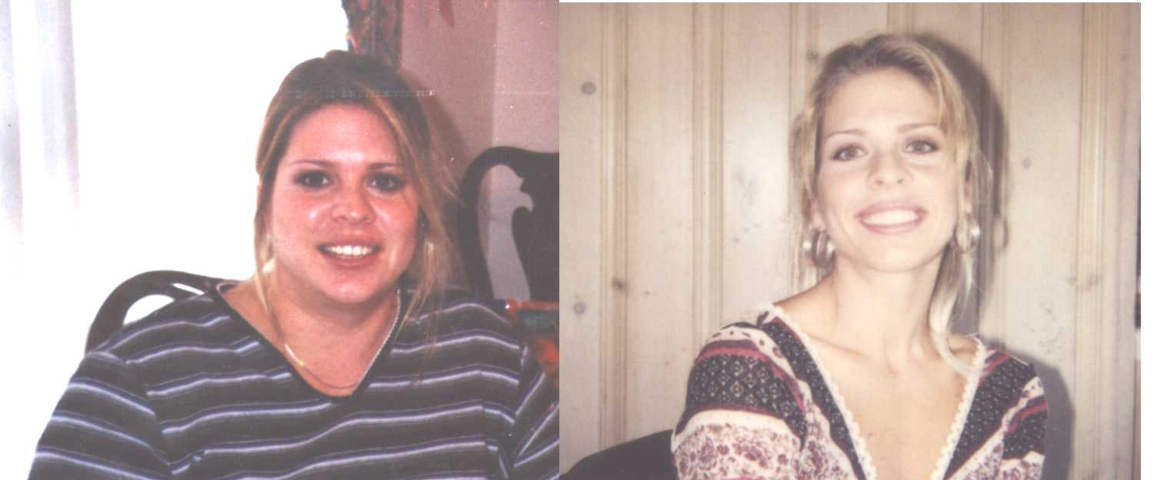
A Wonderful Example
Mitzi Mager Lost 90 Pounds in 90 Days!

Slide 37
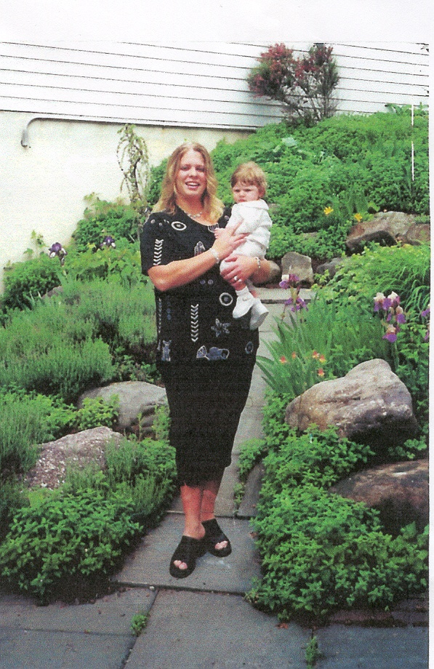
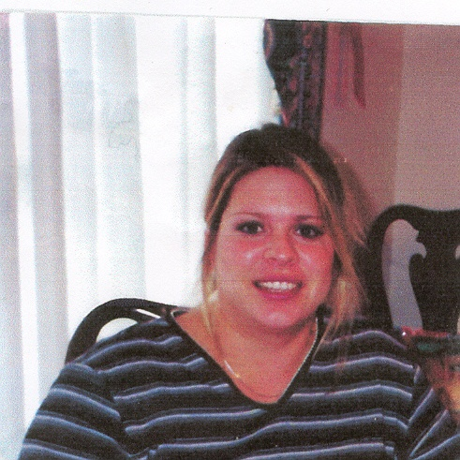
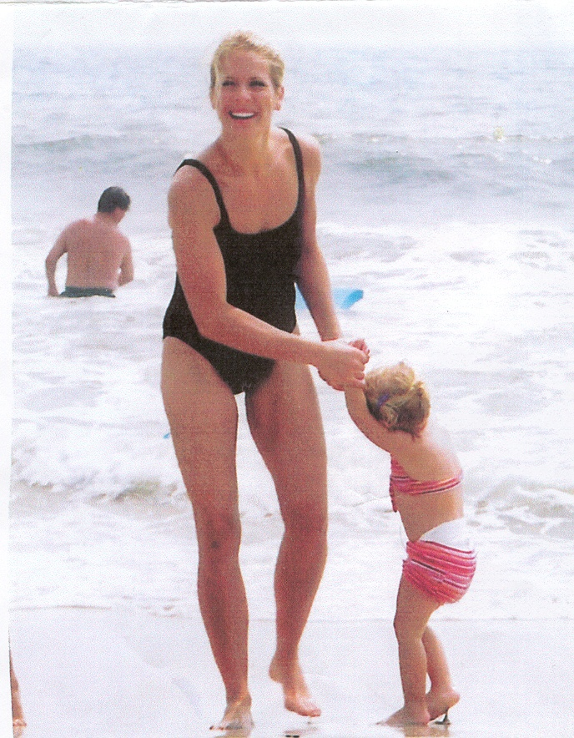
Mitzi Mager – Lost 90 lbs. in 90 days

Slide 38

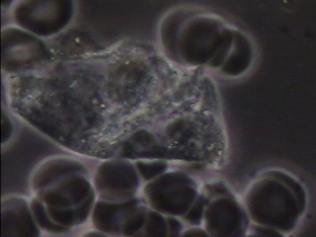
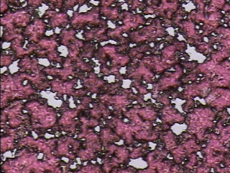
Andrea Dare – Atkins Diet – Overweight & Constipated
Live Blood Before
Before at 146 pounds
Dried Blood Before

Slide 39
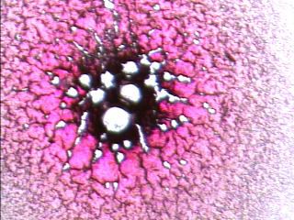
The Protein Diet Blood Profile
Undigested Proteins in the small bowel

Slide 40

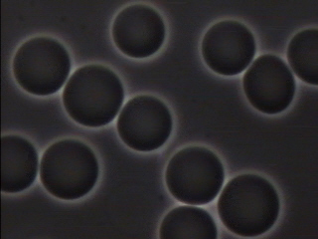
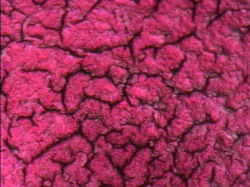
Andrea Dare – The pH Miracle Plan
Lost 15 kilos and went from a
Size 10 to a Size 2 in 12 weeks
Live blood after 12 weeks
After at 116 pounds
Dried blood after 12 weeks

Slide 41
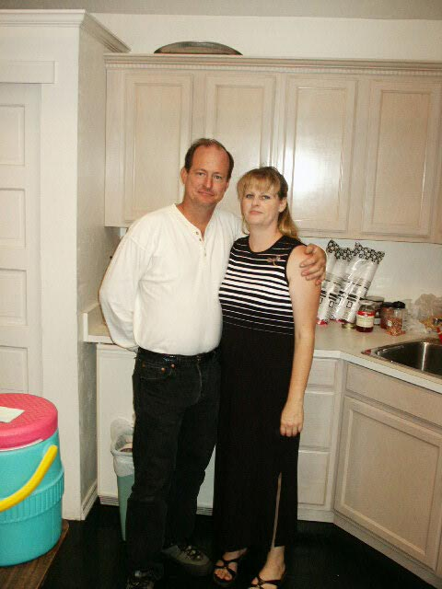
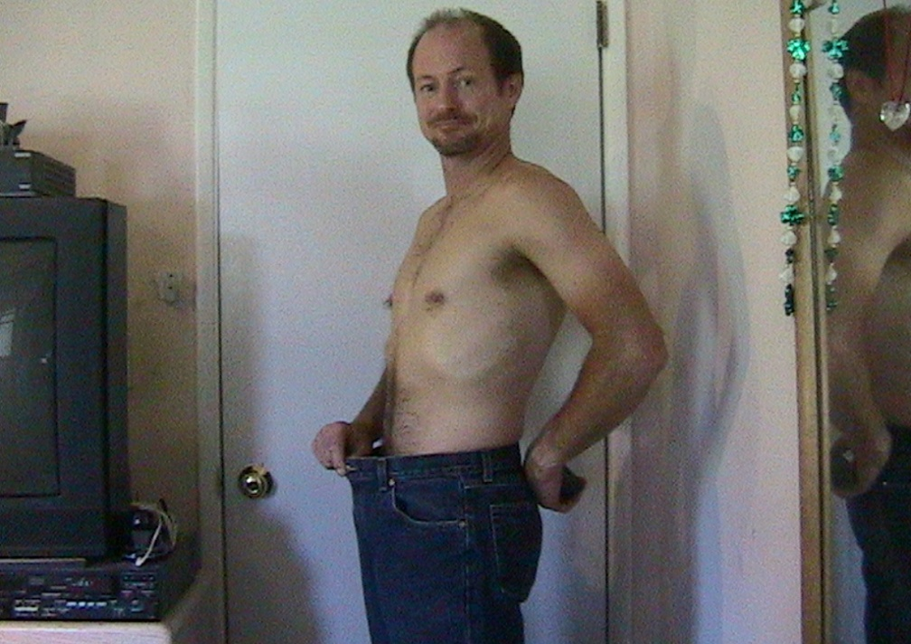
Michael and Andrea Dare pH Miracles
Pierce Brosnan
Pierce Brosnan
Lost 31 pounds in 8 weeks and 6 inches
No more back pain from construction work

Slide 42


David Gorder – Lost 50 kilos on The pH Miracle Plan
165 pounds and
13 pant sizes smaller
275 pounds - 46” waist

Slide 43




Michael Mayne Before at 150 kilos!

Slide 44




Mike Mayne 12 Weeks on The pH Miracle for Healthy Weight Loss
Weighing in at 100 kilos

Slide 45


Michael & Barbara Mayne Before & 12 Weeks After The pH Miracle Plan
Mike lost 70 pounds in 12 weeks
Barbara lost 25 pounds and went from a
12 dress size to an 8.
Mike weighing in at 277 pounds

Slide 46

Ryan Marcotte A pH Miracle
I was very unhappy with the way my body was looking, so I entered a fitness and weight loss contest connected to a best-selling book. I was very dedicated, but I just wasn’t having any success. Then I switched to the pH Miracle program, and lost 31 pounds of fat while gaining 11 pounds of muscle – in just 12 weeks! I went on to be one of the top winners in that original contest, even beating the last year’s grand champion. All without meat, chicken or protein drinks, building muscle with blood and building blood with green foods and green drinks.
Finalist in the Body for Life Contest
Lost 31 pounds of fat
Gained 11 pounds of muscle
In 12 weeks on the pH Miracle Plan

Slide 47


Sandra Johnson – Type II Diabetes & High Blood Pressure
Notes:
47

Slide 48
Why is Heart Disease the Leading Cause of Death In the US?
Acids from our lifestyles and diets tenderize and weaken the heart that leads to heart failure.
A weak heart muscle is only possible when it is being marinated in an acidic soup.
This is why cancer will never exceed heart disease in the number of deaths. Your heart will fail before you end up with cancer.
NO one ever dies from cancer. The heart will always fail before the cancer acid ferments the body.
“For the life of all flesh is the blood” (Deut. 17:14) Since the heart is the main muscle that pumps or circulates these life giving cells, when the heart stops there is no blood or life circulation and death is eminent.

Slide 49

High Protein DIE IT like South Beach and Atkins = Heart Attack
“I’ve got a problem”
Ex-President Clinton had been on the South Beach Diet.
“I’m eating better and working out hard”
Clinton at the age of 58, was admitted to the New York Presbyterian Hospital after complaining of chest pain and shortness of breath.
Four of the arteries supplying blood to the heart were so clogged that doctors used vessels from his legs to funnel blood around them.
Clinton had a quadruple by-pass.

Slide 50
US Coronary Interventional Procedures

Slide 51
MRFIT: Correlation Between Cholesterol Levels and CHD Death
Age-Adjusted
6-year CHD
Death rate per
1000 men
Serum Total Cholesterol (mgdl)
Martin MJ et al, Lancet 1986; H-933-936

Slide 52
Blood Cholesterol is an Indicator of an Over Acidic State NOT a Risk for Heart Disease
Your risk factor for CAD reduces significantly when your cholesterol exceeds 300 mg/dl
% of Population
CHD Risk and Total Serum
Cholesterol in Framingham
Total Serum Cholesterol (mg/dl)
80% of people who develop CAD have the same blood cholesterol values as those
who do NOT develop CAD. 35% of CHD Occurs in people with < 200 mg/dl.

Slide 53


Slide 54

Uric and Lactic Acid

Slide 55

Orotic Acid from Lack of Oxygen

Slide 56
Cardiovascular Disease & the Alkaline Diet
Alkaline Minerals Critical to Prevention of CVD or CAD
In the Journal of Orthomolecular Medicine, Joseph Campbell provides a thorough review of the scientific literature surrounding minerals and disease and highlights that the alkaline minerals, magnesium and calcium, are critical to the prevention of cardiovascular disease (CVD). He also highlights that “Excessive consumption of acid producing foods, results in metabolic acidosis. When this occurs, the parathyroid hormone stimulates the removal of calcium from the bones and teeth (osteolysis), to buffer or neutralize the excess acidity. After many years, such calcium loss results in depleted bone, bone weakness and structure.”
Source: Journal of Orthomolecular Medicine Vol. 10, No. 3 & 4, 1995

Slide 57

Maren Hale – Lost over 70 lbs.

Slide 58
Maren’s Cholesterol History
 | Dec 96 | Dec 98 | Dec 99 | Dec 00
Cholesterol <200 | 441 | 338 | 296 | 212
Triglycerides 35-135 | 226 | 67 | 53 | 45
HDL >35 | 39 | 56 | 71 | 75
LDL <130 | 357 | 269 | 214 | 129
VLDL 2-38 | 45 | 13 | 11 | 8
LDL/HDL | 9 | 5 | 3 | 1.7

Slide 59
What is Cancer? or What is a Cancer Cell? and What is a Tumor? According to Dr. Robert O. Young
Cancer is not a cell but a poisonous acidic liquid.
A cancer cell, is a cell that has been spoiled or poisoned by metabolic or gastrointestinal acids.
A tumor is the body’s protective mechanism to encapsulate spoiled or poisoned cells from excess acid that has not been properly eliminated through urination, perspiration, defecation or respiration.
The tumor is the body’s solution to protect healthy cells and tissues.
Cancer is a systemic acidic condition that settles at the weakest parts of the body – not a localized problem that metastases.
Metastases is localized acids spoiling other cells much like a rotten apple spoiling a bushel of healthy apples.
There is no such thing as a cancer cell. A cancer cell was once a healthy cell that has been spoiled from acid.
The tumor is not the problem but the solution to protect healthy cells and tissues from being spoiled from other rotting cells and tissues.
The only solution to the acidic liquids that poison body cells causing the affect that medical savants call cancer is to alkalize and energize the body.
In conclusion, the human body is alkaline by design and acidic by function! If we desire a healthy body we must maintain that alkaline design.

Slide 60


You Don’t Get Old You Mold

Slide 61



Slide 62


Lungs and Blood of a Smoker

Slide 63

Dr. Robert O. Young

Slide 64
Why Cells Live ? Change the Water
Beginning on January 17th, 1912 Alexis Carrel a famous French physiologist, researcher at the Rockefeller Institute, New York, and Noble laureate removed a minute piece of heart muscle from an unhatched chicken embryo and placed it in fresh nutrient medium in a stopperd Pyrex flask of his design.
He transferred the tissue every forty-eight hours, during which time it doubled in size and had to be trimmed before being moved to its new flask.
Transferred into a saline solution with the appropriate alkaline minerals.
When he stopped changing the solution after 20 years the heart died.
Alexis Carrel and Charles Lindbergh,: The Culture of Organs, 1938

Slide 65
Why Cells Live!
The secret on Carrel’s chicken heart surviving for 20 years lies in the knowledge that the cell is only as healthy as the fluids it is bathed in. Carrel’s experiment brought us to modern physiology, which says:
“The composition of the body fluids that bathe the outside of the cells must be controlled very exactly from moment to moment and day to day, with no single important constituent ever varying more than a few percent.”
Alexis Carrel and Charles Lindbergh,: The Culture of Organs, 1938

Slide 66
When the pH is wrong, oxygen falls, cells respire in an anaerobic environment by fermentation giving rise to increased acidity - cancer is a result of an ACID environment.
Otto Warburg, Nobel Prize in Medicine, 1932

Slide 67

Live Blood
This is what your red blood cells should look like

Slide 68




But this is what often shows up 99% of time!

Slide 69

Dr. Robert O. Young

Slide 70

Dr. Robert O. Young

Slide 71


Slide 72

Dried Blood enables us to see where acids are settling and in what organs/tissues
This is what your dried blood sample SHOULD look like

Slide 73




But this is what often shows up 99% of the time!

Slide 74
Case Study
Stage 4 secondary breast cancer
34 year old woman who has already done breast cancer before, including a deluxe drug therapy
12 weeks to eliminate the acids of cancer from her body on ‘the pH Miracle Program.”

Slide 75


First Blood Test

Slide 76

Dr. Robert O. Young

Slide 77


Second Test – One Month Later

Slide 78


Third Test – 2 Months Later

Slide 79


4th Test – 3 Months Later
Red blood cells breakdown with heavy
drugs. This is the result of drug therapy.
Clean!

Slide 80
From this (Cancer) To this (No Cancer)
In just 90 days

Slide 81
Alkaline Diet & Cancer
Alkaline Minerals Prevent Cancer Growth
In March 2009, Robey, Baggett, Kirkpatrick et al published a paper in the American Association for Cancer Research Journal proving that alkaline minerals (in this case NaHCO3 – sodium bicarbonate) that raise the extracellular pH of cancer tumor cells and prevent metastasis. Their research shows that the pH of the tumors are always acidic and by using highly alkaline minerals to raise the pH – the growth of the cancer (and involvement of lymph nodes) is prevented.
Source: Cancer Research 69, 2260, March 15, 2009

Slide 82

Steven Birdsall – Metastatic Cancer

Slide 83
pH Miracle Secrets
Health and disease are contextual in nature and not specific in nature. There are no specific disease(s) and no specific health(s) only specific disease and health condition(s) or environment(s).

Slide 84


pH Miracle Secrets
All body cells are the product of blood and the blood is a product of what we eat, what we drink and what we think. Dr. Robert O. Young

Slide 85

Bone Cancer Starts in the Bowels

Slide 86


Slide 87


Slide 88


Steven Birdsall – Metastatic Cancer

Slide 89
Cancer Thrives in an Acidic Environment
Also in Cancer Research Journal, in 2006, Gatenby, Gawlinski et al researched and discovered that “chronic exposure of normal tissue to an acidic microenvironment produces toxicity by: (a) normal cell death… and (b) extracellular matrix degradation”. They proffer that glucose imbalance (an acid lifestyle) leads to a chronically acidic microenvironment (the normal cells and molecules that surround a tumor cell) which provides the perfect base for cancer.
Source: Cancer Research 66, 5216-5223, May 15, 2006

Slide 90


Without Surgery – Hyper-Alkalization with The pH Miracle Lifestyle and Diet

Slide 91

Dr. Robert O. Young

Slide 92
Alkaline Minerals Prevent Osteoporosis
Acidosis & Osteoporosis
A recently published study in the Journal of Clinical Endocrinology and Metabolism (Vol 94, No 1 96-102, 2009) has provided further evidence that the consumption of and supplementation with alkaline minerals is essential for good health. The objective of the study was to understand the effect of alkaline minerals (potassium bicarbonate, sodium bicarbonate and potassium chloride) on bone health – specifically, the ability of these alkaline minerals to slow the bone re-adsorption rate and calcium excretion.
The participants who were taking the bicarbonate supplements had significant reductions in urinary N-telopeptide and calcium excretion when compared to the control group. This means that when taking the alkaline minerals, bones remained stronger and healthier.
Source: Journal of Clinical Endocrinology and Metabolism (Vol 94, No 1 96-102, 2009)

Slide 93

Reversing Prostate Cancer
PSA 7.6 December 2008
PSA in 3 weeks on The pH Miracle Plan 1

Slide 94


Ephriam Kubai – Prostate Cancer

Slide 95


Ephriam Kubai – 3 Weeks Later

Slide 96









Glen Ezekiel – High PSA
PSA 37
2 weeks 17
4 weeks 9.5
8 weeks 7.2
12 weeks 5.3

Slide 97



Glen Ezekiel
PSA from 37 to 5.3

Slide 98


Light is the Driving Force of Every Cell
“Absorption and organization of sunlight, the very essence of life, is almost exclusively derived from plants. Plants are therefore a biological accumulation of light. Since light is the driving force of every cell in our bodies, that is why we need plants”
Dr. Klinik Bircher-Benner

Slide 99



Light = Green = Blood = Flesh

Slide 100


You Build Muscle with Blood not Proteins – Blood becomes Muscle

Slide 101


The Strongest Animals in the World build Muscle and Bone with Blood

Slide 102

For the Life of All Flesh is the Blood
Leviticus 17:14

Slide 103

For the Life of All Flesh is the Blood
Leviticus 17:14
Blood is the most basic material of the human body
Body cells from all types of tissue are continually being formed from the blood
It’s actually a two-way street, and body cells can also be transformed into blood cells
Normal blood production originates in the small intestine

Slide 104


27 feet long
7,200 square feet of surface area
3 to 4 million red blood cells made per second
New blood every 120 days
The heart beats 100,000 times a day, moving 21/2 ounces of blood per pulse – about 8 tons each day.
All the blood circulates throughout the entire body and then through the heart every 3 minutes.

Slide 105


The focal point of blood or life
production
is in the small intestine

Slide 106




The Primary Site for Blood Production
Damage to the intestinal villi leads to
many of the symptoms we call disease!

Slide 107
Journal Articles
Journal of Cell Science, Vol 112, Issue 18 3029-2038
EM Slorach, FC Campbell and JR Doris
Stem cells for regeneration found in the crypts of the small intestine

Slide 108

Jejunal Biopsies
Upper left and right pictures show normal villi in finger and leaf patterns.
Bottom left and right pictures show abnormal mosaic pattern with obvious damage to the villi.
Notes:
Sticky mucus can cause damage to the villus by causing congestion. Villus then become smooth and cannot catch the food. Food goes in whole and come out whole.
The 10-day Liquid Feast can help to clear out the crypts in the intestinal villus.
This is the case when people can’t digest food, are passing whole food, or don’t gain weight. It’s a problem in both overweight and underweight, but it’s particularly a challenge for people who are underweight because they must begin losing weight before they can start to put on healthy cells.
Take out the beef, pork, chicken, dairy and put in SuperGreens and Aloe Vera to clear out the crypts.
It’s important to do a Feast to get food into the body and to clear out the crypts in the intestinal villas. Diarrhea and constipation are part of the process of cleansing. It may take 12-16 liters of SuperGreens a day to repair the small intestine.
Innerlight protocol:
Fibrada – Fiber is like a sponge that absorbs acids. Not necessary in an alkaline diet.
Segrada – Stronger action. Helps to break up pockets of proteins.
Whole leaf aloe vera
Lemon water
Warm water and real salt
The stool during the Feast can go from light brown to brown to black.

Slide 109

The Stomach is an Organ of Contribution NOT Digestion
Salt + Water + Carbon dioxide = Sodium bicarbonate + Hydrochloric acid
NaCl + H2O + CO2 = NaHCO3 + HCL

Slide 110

The Law of Change
Pleomorphism or Biological Transformation
Woman 21 years – Type 1 Diabetes
Notes:
110

Slide 111

Dr. Young Validates Pleomorphism
Notes:
111

Slide 112

Dr. Young Validates Pleomorphism
Notes:
112

Slide 113

The Phenomenon Pleomorphism
The rapid evolution of matter into different forms across traditional taxonomic lines.
Colloidal microzymas evolve intracellularly into more complex forms.
First the primitive stage of filterable bacteria.
Second are the cell-wall deficient forms and full bacteria.
Third comprises of the yeast and/or fungus.
And the culminate form of mold is the fourth stage.
Collectively, I refer to all biological transformations as EMPO or exotoxic/mycotoxic producing organisms.
EMPO excretions are all acidic and are called MAT, or microzymian acid toxin.
Bacteria, yeast or mold are all products of cellular transformation not the cause of the transformation.
EBV- Chronic Fatigue – Male 42
Notes:
113

Slide 114


Dr. Young at the University of Paris
Notes:
114

Slide 115

The Law of Change
Doctrine of Pleomorphism
Antoine BeChamp (1816-1908)
Microzyma Theory
Germs are born in us
Father of Pleomorphism
Many Forms - Many Functions
Germs are transmutations of organized healthy cells
Germs do not cause disease
Disease comes from within
Germs are nothing the Terrain is everything
Discovered Fermentation
Contextual Scientist
Notes:
115

Slide 116

A New Paradigm for Sickness & Disease
Physical and/or Emotional Disturbance
Cellular Disorganization
Developmental Morbidity
Excess Acidity
Acids are the expression of ALL Sickness and Disease
Notes:
116

Slide 117

Doctrine of Monomorphism
Louis Pasteur (1822-1895)
In 1840 Jacob Henle in his essay “On Miasmata and Contagia” formulated the modern germ theory that disease grew out of and from bacteria.
Germ Theory – In 1860 Pasteur suggested that living organisms not chemical chain reactions caused fermentation.
Father of Monomorphism
One form one function
Germs are unchangeable
Germs invade the body
Germs cause disease
Vaccinations
Classical Scientist
Notes:
117

Slide 118


The Dark Side of Louis Pasteur
Notes:
118

Slide 119
Emile Rouz & Alexandre Yersin
1889
Protégé’s of Louis Pasteur.
They grew a broth thick with diptheria bacteria and used compressed air to force the broth through a filter of unglazed porcelain.
NO bacteria or solids could pass through the porcelain – only liquid.
They then sterilized the liquid.
They took the sterilized liquid of diptheria toxin and injected into animals.
The liquid killed not the bacteria!
Notes:
119

Slide 120
1994 Dr. Robert O. Young discovers the pH factor in triggering biological transformation of the red blood cells into bacteria and yeast.
Notes:
120

Slide 121

The Phenomenon of Pleomorphism Documented March 15th, 1967
Published paper in the Annals of the New York Academy of Sciences, Volume 141, ART.1, pages 1-671.
Page 178 -180, “Experimental Isolation of Organisms” from cancerous tumors
Page 179, 2) Pleomorphism, “one of the chief characteristics of these organisms in their pleomorphism, allowing them to appear in different forms at different times even though they originated from a single plate colony . . . First culture from this cancerous node consisted of diphtheroid in form with many acid-fast particles . . on further subculture on tryticase soy agar, long filamentous forms appeared . . . later cultured on von Brehmer’s medium, the filamentous form seemed to be lost and pure coccoid forms appeared with some tendency to aggregate in line formation . . . Continued culture on this medium yielded dispersed isolated cocci, many which were acid-fast.

Slide 122
“The Human Body is an acid producing organism by function yet it is an alkaline organism by design”
Dr. Robert O. Young
www.articlesofhealth.blogspot.com

Slide 123
Understanding Acid/Alkaline
Balance
www.articlesofhealth.blogspot.com

Slide 124

The pH Scale
The pH scale is logarithmic and a change of 1 reflects a tenfold change in pH.
An acid pH of 6 is ten times more acidic than neutral.
A base ph of 8 is ten times more alkaline than neutral.
Low pH values indicates high concentrations of H+ or protons.
High pH values indicate low concentrations of H+ or protons and high concentrations of OH- or electrons.

Slide 125




Blood & Tissue pH
7.365
Blood
1 2 3 4 5 6 7 8 9 10 11 12 13 14

Slide 126
Blood pH must be kept close to 7.36
Hydrogen ion is extremely reactive and effects many molecules which regulate physiological processes.
Blood is set at a slightly alkaline level of 7.365, (pH 7.0 is neutral).
A change of pH of 0.2 units in either direction is considered serious.
Blood pH below 6.9 or above 7.9 are usually fatal if they last more than a short time.
The correct urine and saliva pH is 7.2 or higher.
7.365
1 2 3 4 5 6 7 8 9 10 11 12 13 14
This is the blood’s correct pH

Slide 127

Ratio for Neutralization of Acid & pH Balance of the Blood & Tissues
It takes 20 parts of Alkalinity (Sodium Bicarbonate) to neutralize one part Acidity (Carbonic Acid)
www.articlesofhealth.blogspot.com

Slide 128
The Major Buffers of Acidity
Bicarbonate
Hemoglobin
Phosphate
Plasma Proteins
Electrolyte Buffers
Low Density Lipos
Hormones
H2O

Slide 129
How We Become Acidic
Mainly due to over consumption of:
  1st Ingestion Protein
  2nd Indirect & Direct Ingestion of Sugar
When protein breaks down it forms strong acids including nitric, sulphuric, phosphoric and uric acid
  like “battery acids” they will burn holes in clothes, metal, and human cells
We need less than 5 grams of protein daily
The average American eats over 200 grams per day
The destruction of Mayan Indians of Central and South America was from demineralization as if they had been soaked in excess acid

Slide 130
How Acid is Made
The “parietal” or cover cells of the stomach split the sodium chloride (NaCL)of the blood
The sodium (Na) is used to bind with water and carbon dioxide (CO2) to form the alkaline salt, sodium bicarbonate (NaHCO3)
H20 + CO2 + NaCL ⬄ NaHCO3 + HCL
For each molecule of NaHCO3 made, a molecule of HCL (hydrochloric acid) is made and secreted into the digestive system to be eliminated
CL from the sodium chloride binds to an acid or proton forming HCL as a waste product of sodium bicarbonate production

Slide 131
pH & Energy Values
Certain Foods and Drinks
Product Sunny Delight Gatorade Coca Cola Red Bull Energy Twin Lab Ultra Ripped Force Snapple Power Bars 7-up | pH 2.81 2.95 2.51 3.26 2.83 3.22 2.83 2.93 3.25 | Charge +232mv +265mv +282mv +214mv -14mv +254mv +256mv +266mv +265mv

Slide 132
pH & Energy Values
Certain Foods and Drinks
Product Bud Light Heineken Bartles &James Zima Malt Lipton’s Tea Decaf Coffee Salvador Coffee Soy Sauce Urine | pH 4.25 4.28 2.84 3.03 2.79 5.22 5.09 4.45 7.2 | Charge +177mv +144mv +248mv +257mv +244mv +142mv +140mv +69mv -56mv

Slide 133
pH & Energy Values
Certain Foods and Drinks
Product Spinach Juice Wheat Grass Barley Greens InnerGreens B/G Algae Barlean’s Ener Prime Tahitian Noni Hawaiian Noni | pH 6.46 6.19 5.40 6.20 6.30 5.69 5.07 3.31 3.82 | Charge +81mv +36mv +140mv +258mv +129mv +147mv +41mv +300mv +255mv

Slide 134


Slide 135

Brendan Fraser on Acid

Slide 136

Val Kilmer on Acid

Slide 137

Alex Baldwin on Acid

Slide 138

Arnold Schwarzenegger on Acid

Slide 139

Russel Crowe on Acid

Slide 140

Pierce Brosnan on Acid

Slide 141

Clint Eastwood

Slide 142

Deadly Acidic DIE its!
The See Food Diet
Atkins
South Beach
Makers Diet
The Zone
Eat for Your Blood Type
Carbohydrate Lovers
Protein Lovers
Dr. Phil’s
YO-YO Diet

Slide 143


The See Food DIE it or S.A.D.
Kristie Alley’s BMI is 307 pounds with
a BMI of 46.67 indicating she is morbidly
obese. Her ideal weight is 150 pounds.

Slide 144

Dr. Atkins or Dr. Fatkins?
New DIE it Revolution!
After Dr. Atkins' so-called accidental death the autopsy report revealed that he was not only obese but his arteries were full of plaque.
I perceive that Dr. Atkins had a heart attack and then slipped, fell and hit his head.

Slide 145

High Protein Diets = High Acidity = Disease from diets such as Atkins and South Beach
Loss of energy 50%
Constipation 50%
Bad Breath 34%
Difficulty concentrating 31%
Gallbladder problems14%
Heart problems10%
Reduced kidney function 9%
Kidney stones 9%
Elevated cholesterol 8%
Gout 6%
Osteoporosis 6%
Physicians Committee for Responsible Medicine

Slide 146


The Effect of One Meal of Bacon and Eggs at the Cellular Level
Before
After

Slide 147

What About Our Children?
Twenty years ago 5% of American kids were overweight
Today 15% heading to 20% are overweight.
IN 1969 80% of the kids exercised.
Today 20% of the kids exercise.

Slide 148


Slide 149

Here are a Few of the Major Contributors to Childhood Obesity!
Children today are eating and drinking over 200 pounds of sugar and 200 pounds of animal flesh each year.
These are both highly acidic and damaging to the intestinal villi.

Slide 151


Over – Acid Diet Is Killing Us

Slide 152



Obesity is a Worldwide Problem
Children
in
China

Slide 153

Children
in
Italy.

Slide 154


Children in New York City

Slide 155
You are not overweight You are over acid!

Slide 156


Slide 157



Slide 158
What Causes Diabetes?
The first signs of increase blood sugars are the result of constipation and/or damage to the villi of the small intestine.
Since the body needs energy to run and when the bowels are congested or damaged the body wastes or converts body cells to electrical energy. The result is increased blood sugars in the plasma.
Increased blood sugars in the plasma is from tissue breakdown.
Just like a banana when it ripens becomes sweeter so you become more sweet as your body cells are broken down for energy.
The cell runs on electricity not sugar and proteins.
Cut out the sugar and protein and eat electron rich green alkaline foods and you will reverse the symptoms of diabetes.
The word diabetes means to, “melt into sugar.”

Slide 159

Pima Indians and Fry Bread
2 out of 3 Pima Indians are diabetic!
Notes:
159

Slide 160

Sandra Hoy-Johnson – Type II Diabetic &
High Blood Pressure
Diagnosed with High Blood pressure in 1980
Blood Pressure reading from 150/90 to 180/100
Started Greens and alkaline water on 5/12/01
Blood Pressure reading from 111/50 to 129/78
Blood Sugar from 153 to 228
Started Greens and alkaline water on 5/12/01
Blood Sugar from 83 to 120
Lost over 50 lb. from 5/12/01 to 7/18/01
Notes:
160

Slide 161




Dave Serfas Blood Glucose – Oct 2002 - Apr 2003
Notes:
161

Slide 162
Results of the Diabetic Controlled Study
Case | Weight Before | Weight After 3 months | Blood Pressure Before/After | Total Cholesterol Before/After | Sugar Levels Before | Sugar Levels After
54 Female Type II | 344 | 296 | 128/86 116/64 | 174 136 | 36/210 mg/dl | 111 mg/dl
38 Female Type II | 267 | 233 | 116/86 110/76 | 265 172 | 126 mg/dl | 74 mg/dl
59 Male Type II | 270 | 248 | 140/78 122/70 | 463 238 | 277 mg/dl | 165 mg/dl
62 Male Type II | 243 | 211 | 148/100 124/86 | 252 180 | 206 mg/dl | 133 mg/dl

Slide 163
Results of the Diabetic Controlled Study
Case | Weight Before | Weight After 3 months | Blood Pressure Before/After | Total Cholesterol Before/After | Sugar Levels Before | Sugar Levels After
36 Female Type II | 210 | 177 | 120/80 110/60 | 260 199 | 50/230 mg/dl | 98 mg/dl
52 Male African American | 267 Type II | 233 |  | 259 192 | 299 mg/dl | 105 mg/dl
36 Male Type I | 115 | 109 |  | 177 | 400 +/ 40 mg/dl | 127/64 mg/dl
55 Female Type II | 307 | 268 |  |  | 127 mg/dl | 110/73 mg/dl

Slide 164
Results of the Diabetic Controlled Study
Case | Weight Before | Weight After 3 months | Blood Pressure Before/After | Total Cholesterol Before/After | Sugar Levels Before | Sugar Levels After
34 Female Type II | 180 | 155 |  |  | 262 mg/dl | 127 mg/dl
53 Male Type I | 112 | 108 |  |  | 123 mg/dl | 114 mg/dl
32 Male Type I | 115 | 109 |  |  | 129 mg/dl | 111 mg/dl
32 Male Type II | 150 | 150 |  |  | 339 mg/dl | 127 mg/dl

Slide 165

Reversing Type I Diabetes

Slide 166


Gabriel Roman – Type I Diabetes

Slide 167


Gabriel Roman – 1 Year Later

Slide 168
Arthritis & Alkalinity
Alkaline Mineral Supplementation Decreases Pain in Rheumatoid Arthritis Patients
This incredible study from Institute for Prevention and Nutrition (Germany) provided clear and unquestionable evidence that using an alkaline mineral supplement (30g daily) reduced pain and increased movement in patients with moderately active Rheumatoid Arthritis over a 12-week period.
Source: The Open Nutrition Journal, 2008, 2, 100-105

Slide 169

Sevens Steps to Ideal
Incredible Health
1) Super Hydrate
2) Eat Right for Life
3) Exercise properly
4) Nutritional Supplements
5) Prepare Emotionally
6) Set Goals and write them down
7) Cleanse your body from the inside out.

Slide 170
C.O.W.S.
C = Chlorophyll – Clay – Colon Cleansing
O = Oil – Oxygen
W = Water – Alkaline Water
S = Salt – Sunshine – Sweating - Stretching
You must eat like a cow if you want to be healthy and strong.
R.A.D = Restricted Acid Diet

Slide 171

A New Paradigm for
Health & Energy
The 3 C’s – Cleanse, Control and Construct.
Cleanse the rivers, streams & oceans of your body.
Control acidity
Construct new and healthy cells.
Notes:
171

Slide 172


Morehouse College – Atlanta, Georgia Martin Luther King Chapel
“We must be the change we want to see”

Slide 173

Super Hydrate with Alkaline Fluids
Alkaline water with a pH of at least 9.5
Green drinks to alkalize and build blood.
Green drinks to purify the blood and help maintain the delicate pH balance.
1 liter of pH water with 1 to 3 scoops of Core Greens per 30 pounds of weight.

Slide 174


Mike Flack Before over 400 pounds
Mike Flack after drinking
Greens less 150 pounds
Any Questions ?

Slide 175

Mike Flack a pH Miracle for Healthy Weight Loss

Slide 176
Greens Are the Way to Go
Powdered grass and green salads/veggies have the same structure as blood, and therefore cleanse and feed/build your blood
They also have a very high energy rating, or megahertz – 250 MHz
Death begins at 50 MHz
Hamburger/bacon is equivalent to 3 MHz
Cancer starts at 62 MHz and a urine pH of 5.5 or less!

Slide 177

A Jar of Greens – 250 mHz – this puts light & energy into your body

Slide 178


Eat Right for Life
Focus on green foods, green
drinks and healthy fats!

Slide 179


REPLACE ACID FOOD AND DRINKS WITH ALKALINE FOOD AND DRINK CHOICES

Slide 180




Eclipse – Black Panther
16 years old
150 lbs.
Colon Cancer
Green foods and drinks.
Healthy blood profile
July 2003
July 2003
October 2003

Slide 181



Calvin – Bengal Tiger
12 years old
450 lbs.
Liver Stress
Eating more green foods and drinks.
Before July 2003
After October 2003

Slide 182


Dairy is a Major Contributor to Acidity

Slide 183


Animal Flesh is Never
Completely Digested
Animal flesh including beef, chicken, turkey, and pork leaves the stomach partially undigested compromising the small and the large bowel.

Slide 184

Here’s your blood before and after eating heavy acidic proteins from beef, chicken, turkey, eggs, and/or pork.
Before eating meat
1 hour after eating meat

Slide 185

Undigested Proteins in the Small Bowel
Normal Coagulated Blood
Abnormal Hypocoagulated Blood from
eating animal flesh!

Slide 186
The China Project
A study looking at the rates of over 50 diseases in rural China vs. the US
Fat intake was twice as high in the US
Fiber intake was three times lower in the US
Animal protein intake was 90% higher in the US
Heart disease death rate was 16.7 fold greater for men and 5.6 fold greater for women in the US
Other diseases were also higher in the US: cancer, osteoporosis and diabetes

Slide 187


Slide 188

Energy of food
Hamburger – 3 mHz

Slide 189

A Living Lentil Sprout – 150 mHz

Slide 190


Nutrients are Electric

Slide 191


Back to the House of Health

Slide 192










Latest Research !
God’s Butter: Avocado
The Awesome Tomato
Cuckoo for Coconuts
Onions/garlic
Cucumbers
Broccoli
Grasses/Sprouts
Real Salt

Slide 193
That’s More Like It!
A living lentil sprout photographed using the same equipment ~well over 150 MHz~

Slide 194




“I no longer feel like I’m stuck in the kitchen…
I feel like I’m painting edible masterpieces
With God’s healing palette!”
Shelley Redford Young

Slide 195

Exercise Properly
The most important part of exercising is to sweat.
Moves the lymphatic fluids that removes acidity from the tissue
Bounce for health, energy and vitality
Deep breath
Laugh for no reason

Slide 196
The Teeter Totter of Life
Acidic
Alkaline
Protons/H+
The
Spiritual
Body
The Mental
Body
Electrons/OH-
Emotional Body or
Psychology
E= Energy in Motion
The Soul or Sol
Physical Body or Physiology
From dust you are and from dust you will return
You are nothing more than a bag of water with a little dirt
Water Salt Chlorophyll Fat
The Four Food Groups
Copyright Dr. Robert O. Young

Slide 197


Prepare Your Emotional Environment
Elaine Boylston has lost over 88 pounds
on The pH Miracle for
Healthy Weight Loss Plan.
For the first time in over 30 years Elaine
is under 200 pounds!

Slide 198

Set Goals & Write it Down
Elaine Boylston kept
an extensive journal.
She wrote down
everything she drank
and everything she ate.
She kept records on all
her measurements.
All forms are free when
you go to our website at:
www.thephmiracle.us

Slide 199

Cleanse Your Body from the Inside Out
All healing starts from the inside out, from the head down and in reverse order as the symptoms have appeared. Restated, it can be put like this: All healing starts from the bowel outward, from the brain centers to the organs they control and in reverse order as symptoms are stored in memory.
Pee your way to health!

